Slide 1
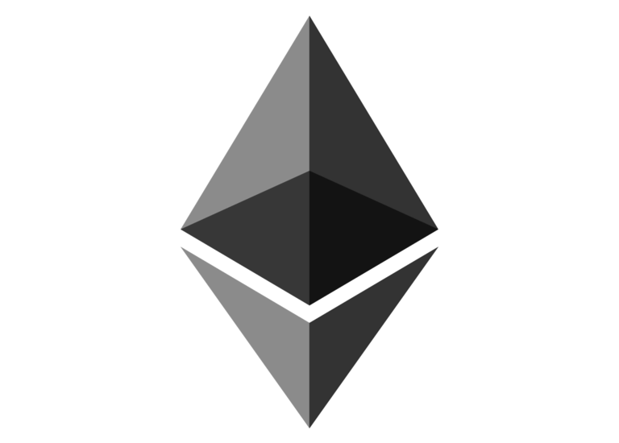
Ethereum
Blockchain App Platform
Technology 2018

Slide 2
Agenda
Overview of Ethereum
Decentralized App Development
Hands-on Demo
Q&A

Slide 3
Ethereum

Slide 4
Blockchain is …
Notes:
Blockchains as a concept are not too hard to understand for programmers. The reason is that most of the complications (mining, hashing, elliptic-curve cryptography, peer-to-peer networks, etc.) are just there to provide a certain set of features and promises. Once you accept these features as given, you do not have to worry about the underlying technology - or do you have to know how Amazon’s AWS works internally in order to use it?

Slide 5
Blockchain is a tool.
Globally shared database
Chain of blocks that contain transactions
Consensus algorithm
Notes:
A blockchain is a globally shared, transactional database. This means that everyone can read entries in the database just by participating in the network.
Blockchains as a concept are not too hard to understand for programmers. The reason is that most of the complications (mining, hashing, elliptic-curve cryptography, peer-to-peer networks, etc.) are just there to provide a certain set of features and promises. Once you accept these features as given, you do not have to worry about the underlying technology - or do you have to know how Amazon’s AWS works internally in order to use it?

Slide 6
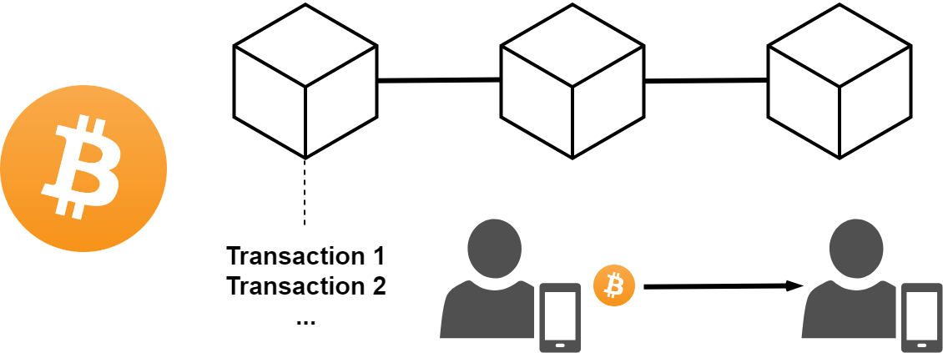
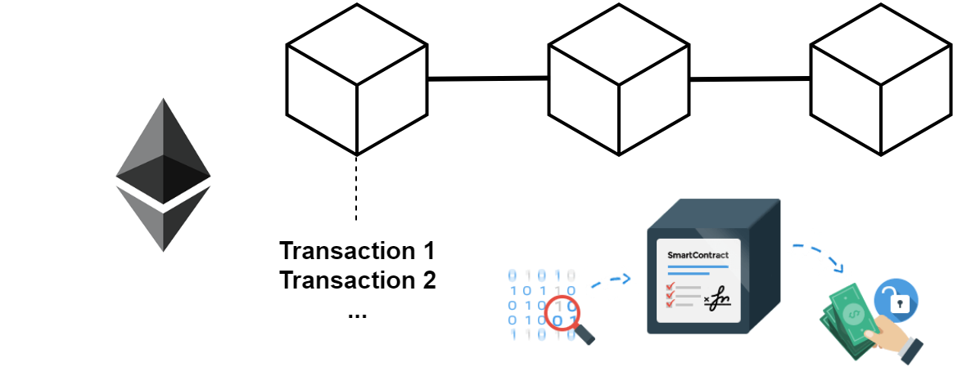
Peer-to-Peer Electronic Cash System
Decentralized App platform
Notes:
Ethereum is an open blockchain platform that lets anyone build and use decentralized applications that run on blockchain technology. Like Bitcoin, no one controls or owns Ethereum – it is an open-source project built by many people around the world. But unlike the Bitcoin protocol, Ethereum was designed to be adaptable and flexible. It is easy to create new applications on the Ethereum platform

Slide 7
dApp
dApp
<Contract>
<Contract>
Ethereum
dApp
dApp
<Contract>
dApp

Slide 8

Ethereum: A world computer
Expensive
Slow
Single thread
The order of messages' execution can be reorganized
<Contract>
<Contract>
<Contract>
A
B
B
A
Notes:
The Ethereum Virtual Machine or EVM is the runtime environment for smart contracts in Ethereum. It is not only sandboxed but actually completely isolated, which means that code running inside the EVM has no access to network, filesystem or other processes. Smart contracts even have limited access to other smart contracts.

Slide 9
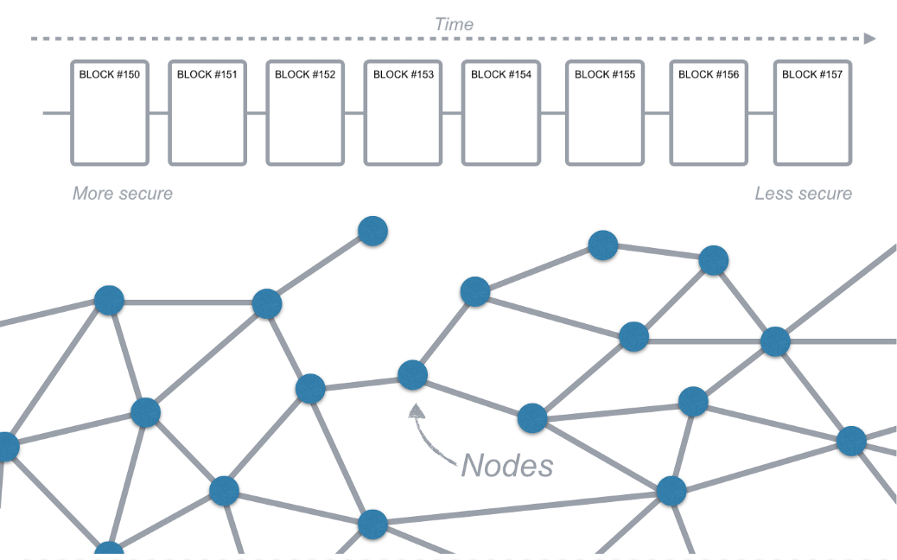
Ethereum: A world computer
Decentralized
Transparent
Secure
<Contract>
<Contract>
<Contract>
Notes:
The Ethereum Virtual Machine or EVM is the runtime environment for smart contracts in Ethereum. It is not only sandboxed but actually completely isolated, which means that code running inside the EVM has no access to network, filesystem or other processes. Smart contracts even have limited access to other smart contracts.

Slide 10
Smart contract is a contract that:
Immutable
Distributed
Executed by Code
Notes:
A blockchain is a globally shared, transactional database. This means that everyone can read entries in the database just by participating in the network.
Blockchains as a concept are not too hard to understand for programmers. The reason is that most of the complications (mining, hashing, elliptic-curve cryptography, peer-to-peer networks, etc.) are just there to provide a certain set of features and promises. Once you accept these features as given, you do not have to worry about the underlying technology - or do you have to know how Amazon’s AWS works internally in order to use it?

Slide 11
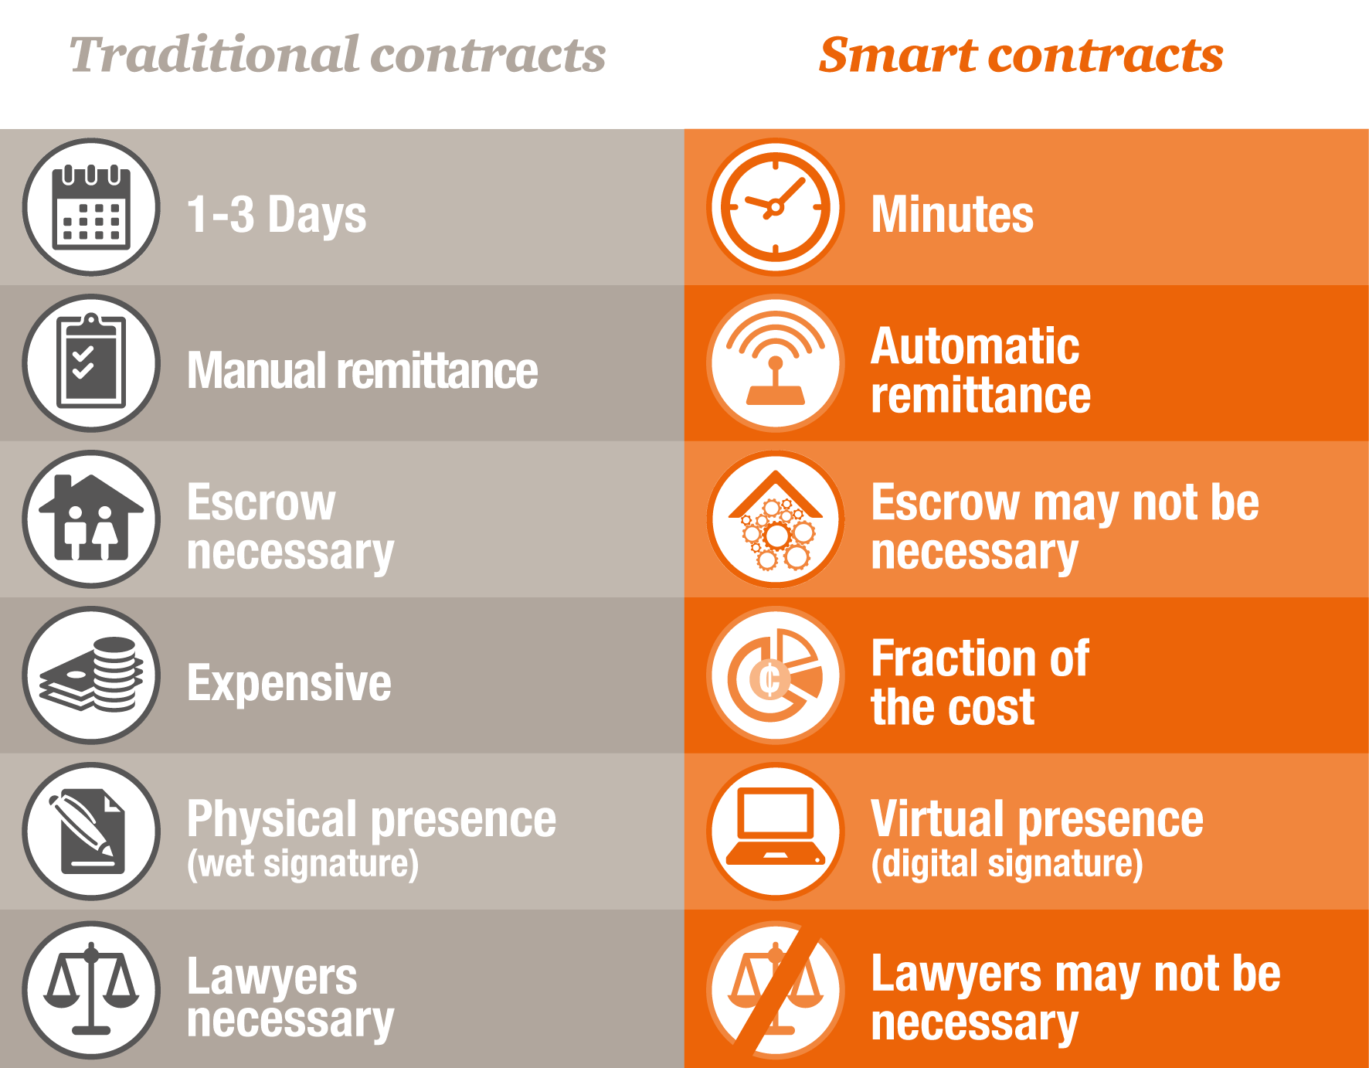
Smart Contract
Notes:
Would you enter in a contract with someone you’ve never met? Would you agree to lend money to some farmer in Ethiopia? Would you become an investor in a minority-run newspaper in a war zone? Would you go to the hassle of writing up a legal binding contract for a $5 dollar purchase over the internet?
The answer is no for most of these questions, the reason being that a contract requires a large infrastructure: sometimes you need a working trust relationship between the two parties, sometimes you rely on a working legal system, police force and lawyer costs.
In Ethereum you don’t need any of that: if all the requisites to the contract can be put in the blockchain then they will, in a trustless environment for almost no cost.
Instead of thinking of moving your current contracts to the blockchain, think of all the thousand little contracts that you would never agree to simply because they weren’t economically feasible or there was not enough legal protection..

Slide 12
Ethereum’s Smart Contract
Application Binary Interface
OP Code
0x6060604052341561000f57600080fd5b5 b60b88061001e6000396000f30060606040 5263ffffffff7c010000000000000000000
00000000000000000000000000000000000
006000350416632ddbd13a8114604657806
34f2be91f146068575b600080fd5b341560
5057600080fd5b6056607a565b604051908
15260200160405180910390f35b34156072
57600080fd5b60786080565b005b6000548
1565b6000805460010190555b5600a16562
[{ "constant": true,
"inputs": [],
"name": "total",
"outputs": [{
"name": "",
"type": "uint256"
}],
"payable": false, "type": "function"
},{
"constant": false, "inputs": [],
pragma solidity ^0.4.0;
contract A {
uint256 public total; function add() {
total += 1;
}
}
7a7a723058203980fdf4ba4267d30a67872
353d9240267848a68557534188a403900f7
"name": "add",
"outputs": [],
Compiler
ab070a0029
"payable": false,
"type": "function"
}]

Slide 13
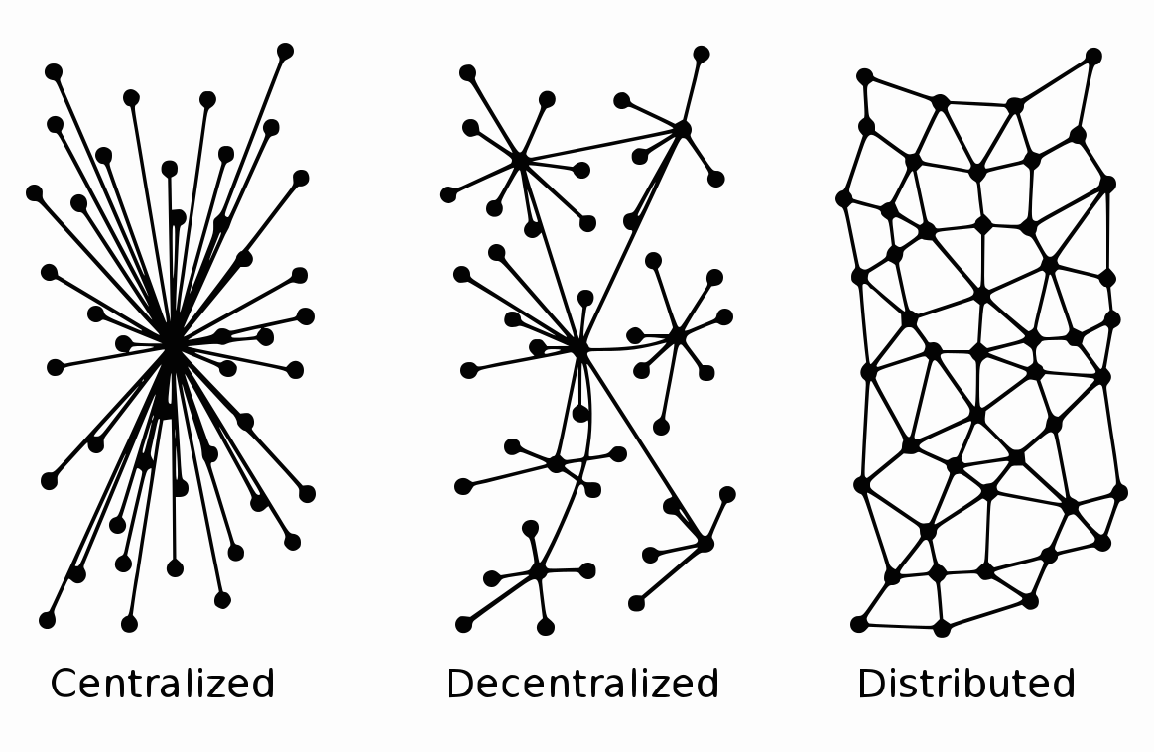
Decentralized System is …

Slide 14
Decentralized Application is …
Decentralized applications (dApps) are applications that run on a P2P network of computers rather than a single computer.
dApps, have existed since the advent of P2P networks. They are a type of software program designed to exist on the Internet in a way that is not controlled by any single entity.
Notes:
Decentralized applications don’t necessarily need to run on top of a blockchain network. BitTorrent, Popcorn Time, BitMessage, Tor, are all traditional dApps that run on a P2P network, but not on a Blockchain (which is a specific kind of P2P network).

Slide 15
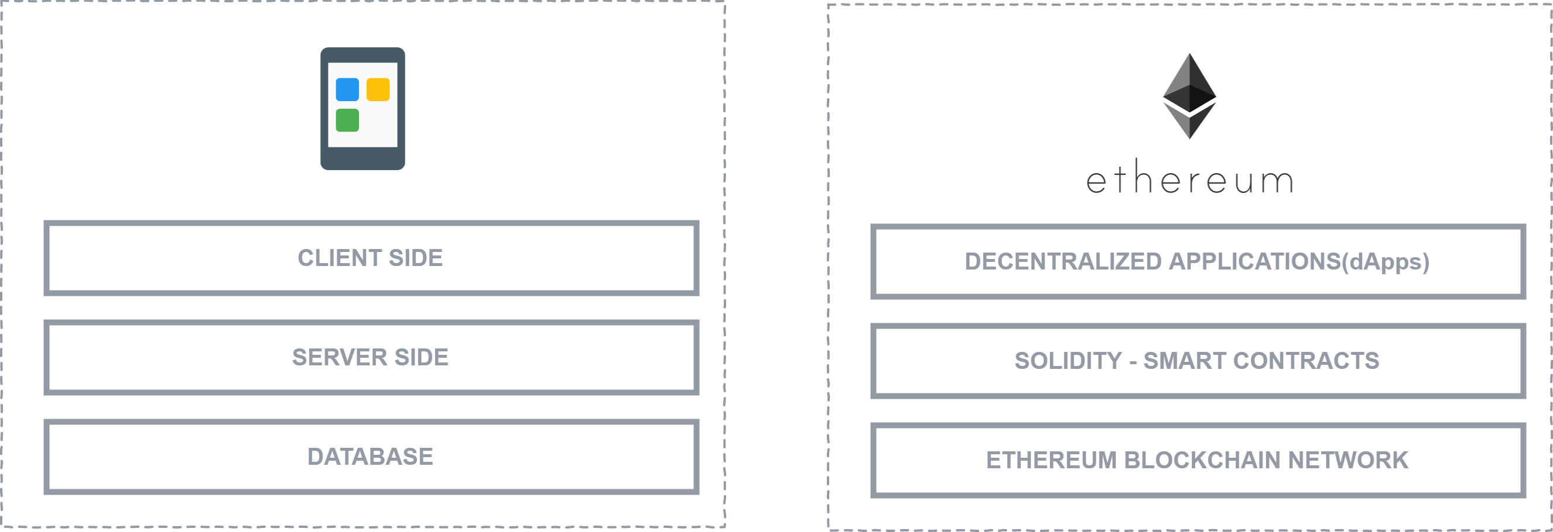
For short

Slide 16
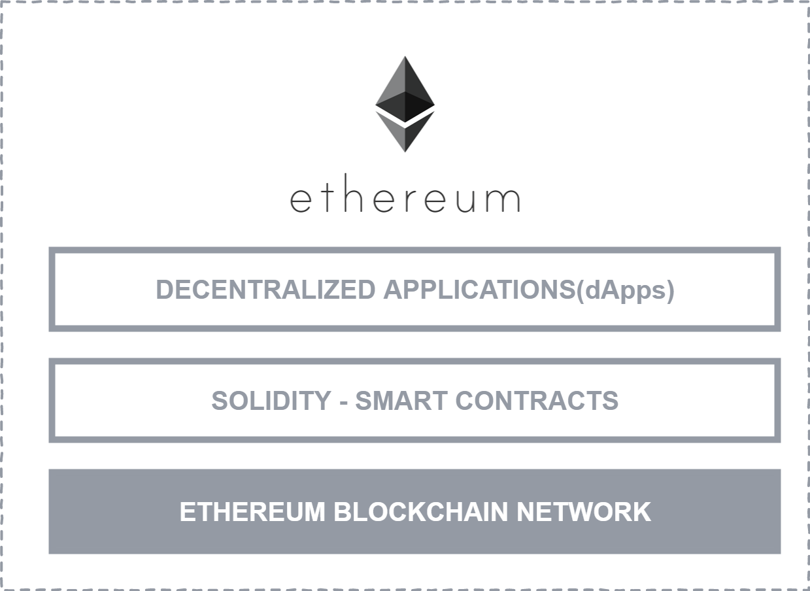

Slide 17
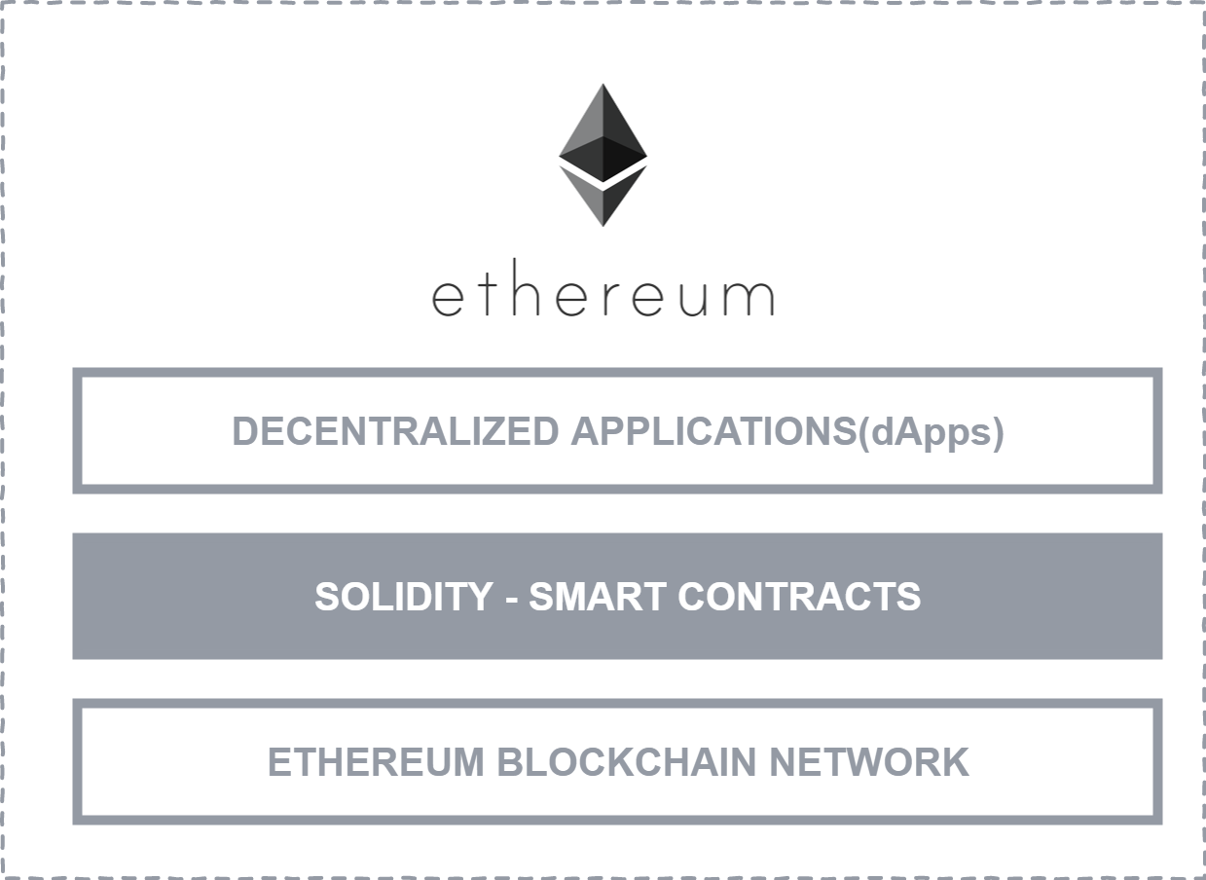
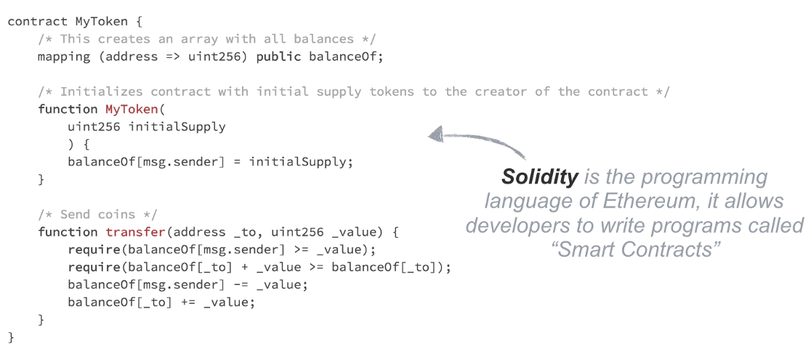

Slide 18
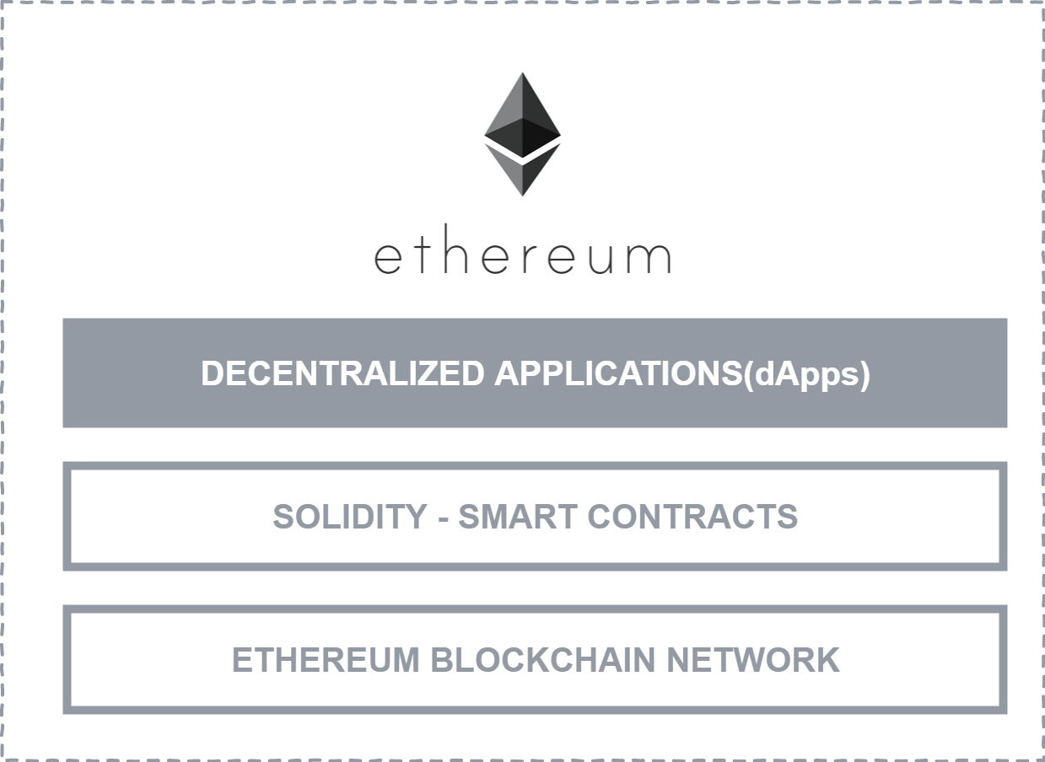
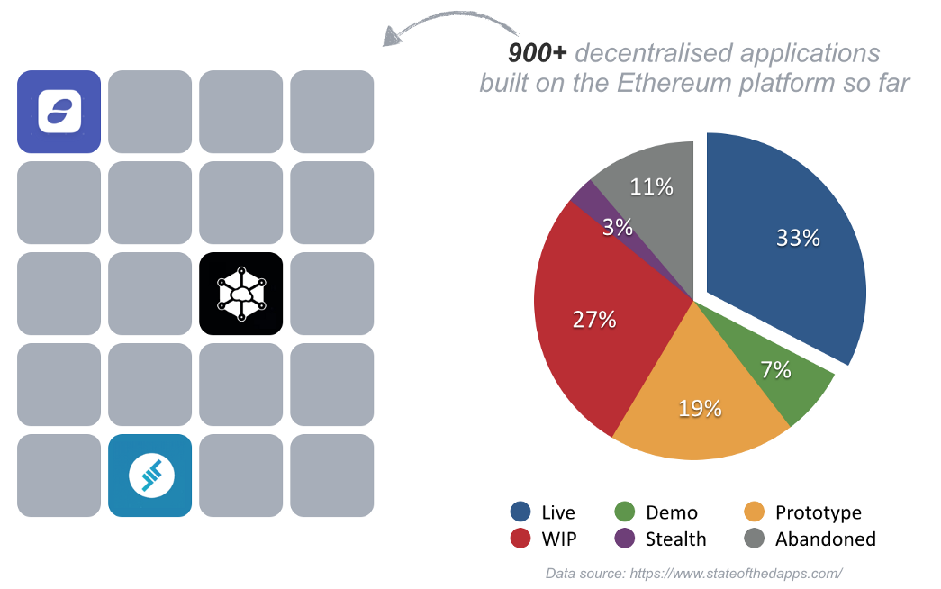

Slide 19
Decentralized App
Development

Slide 20





Development tools
Visual Studio Code
Code Editor
Solidity
Programming Language
Truffle Framework
Development Framework
Ganache
Test Network
MetaMask
Browser Extension

Slide 21
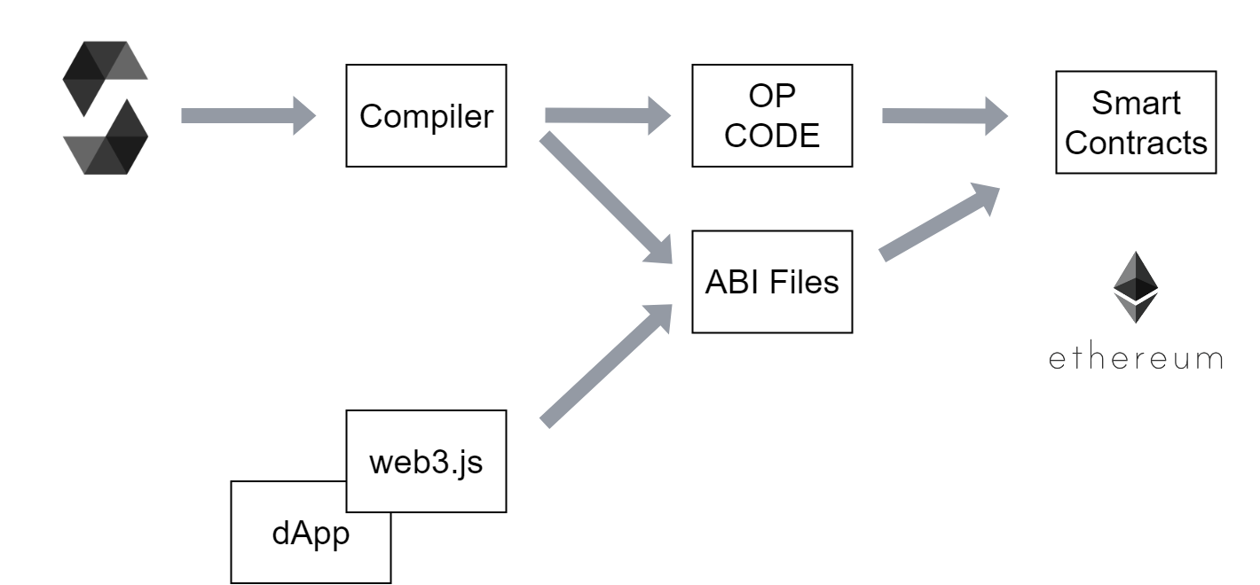
Notes:
Truffle compile -> contracts -> build/ *.jsons…
Truffle migrate -> Account index 0 -> deploy OP code in the ABI files
dApp call ABI files -> call smart contracts in the Ethereum

Slide 22

Transactions
From: Address of the sender
To: Address of the recipient
Value: A number of Ether for transferring in the transaction
Gas price: Price of 1 gas (based on wei)
Gas limit: Total gas that is allowed to use when run this transaction
Nonce: The execution order of transaction of sender account
from(*)
to
value
gas price
gas limit
nonce

Slide 23
Transactions
(X)
B 4
Nonce: 0
From: A
A 10
To: B
Value: 5
(Y)
N
once: 1
From: A
To: C
Value: 8
C 0

Slide 24
Alternative options
Languages | Solidity, Serpent, LLL, Mutan
IDE / Code Editor | Visual Studio Code, Remix IDE, Sublime, Vim, etc.
Ethereum API | Web3.js, web3.py, web3j ,etc.
Test Network | TestRPC , Ganache, Private Ethereum Networks, etc.
Ethereum Implementations | Geth, Eth, Pyeth, Ethereum(J)
Notes:
Mainnet, Private Net, Test Net = Ganache, TestRPC.
Github: Go-etherum, Eth – C++ Etherum, Pyeth Python
Main net: Geth
Private: Geth, Eth,pyeth.

Slide 25
Demo

Slide 26
Real Estate Demo
Create a Smart Contract with Truffle
Add House to a list of House
Buy House from the list and transfer Ether
Migrate to the Test Net
Build & run a dApp using Web3.js to call the Smart Contract.

Slide 27
Preferences
Official Documents: www.ethdocs.org
Infinity Blockchain Lab training documents
Google, Youtube
Demo source: github.com/thailuong12/demoDApp
Notes:
Smart Contract definitions: http://solidity.readthedocs.io/en/v0.4.24/introduction-to-smart-contracts.html
Ethereum official docs: http://www.ethdocs.org/en/latest/

Slide 28
The end.

Slide 29
Appendix

Slide 30


Ethereum
<EC>
<Contract>
address
balance
code
from(*)
to
value
gas price
gas limit
nonce
<Contract>
<EC>
<Contract>
address
balance
nonce
<EC>
<EC>: Externally owned account

Slide 31
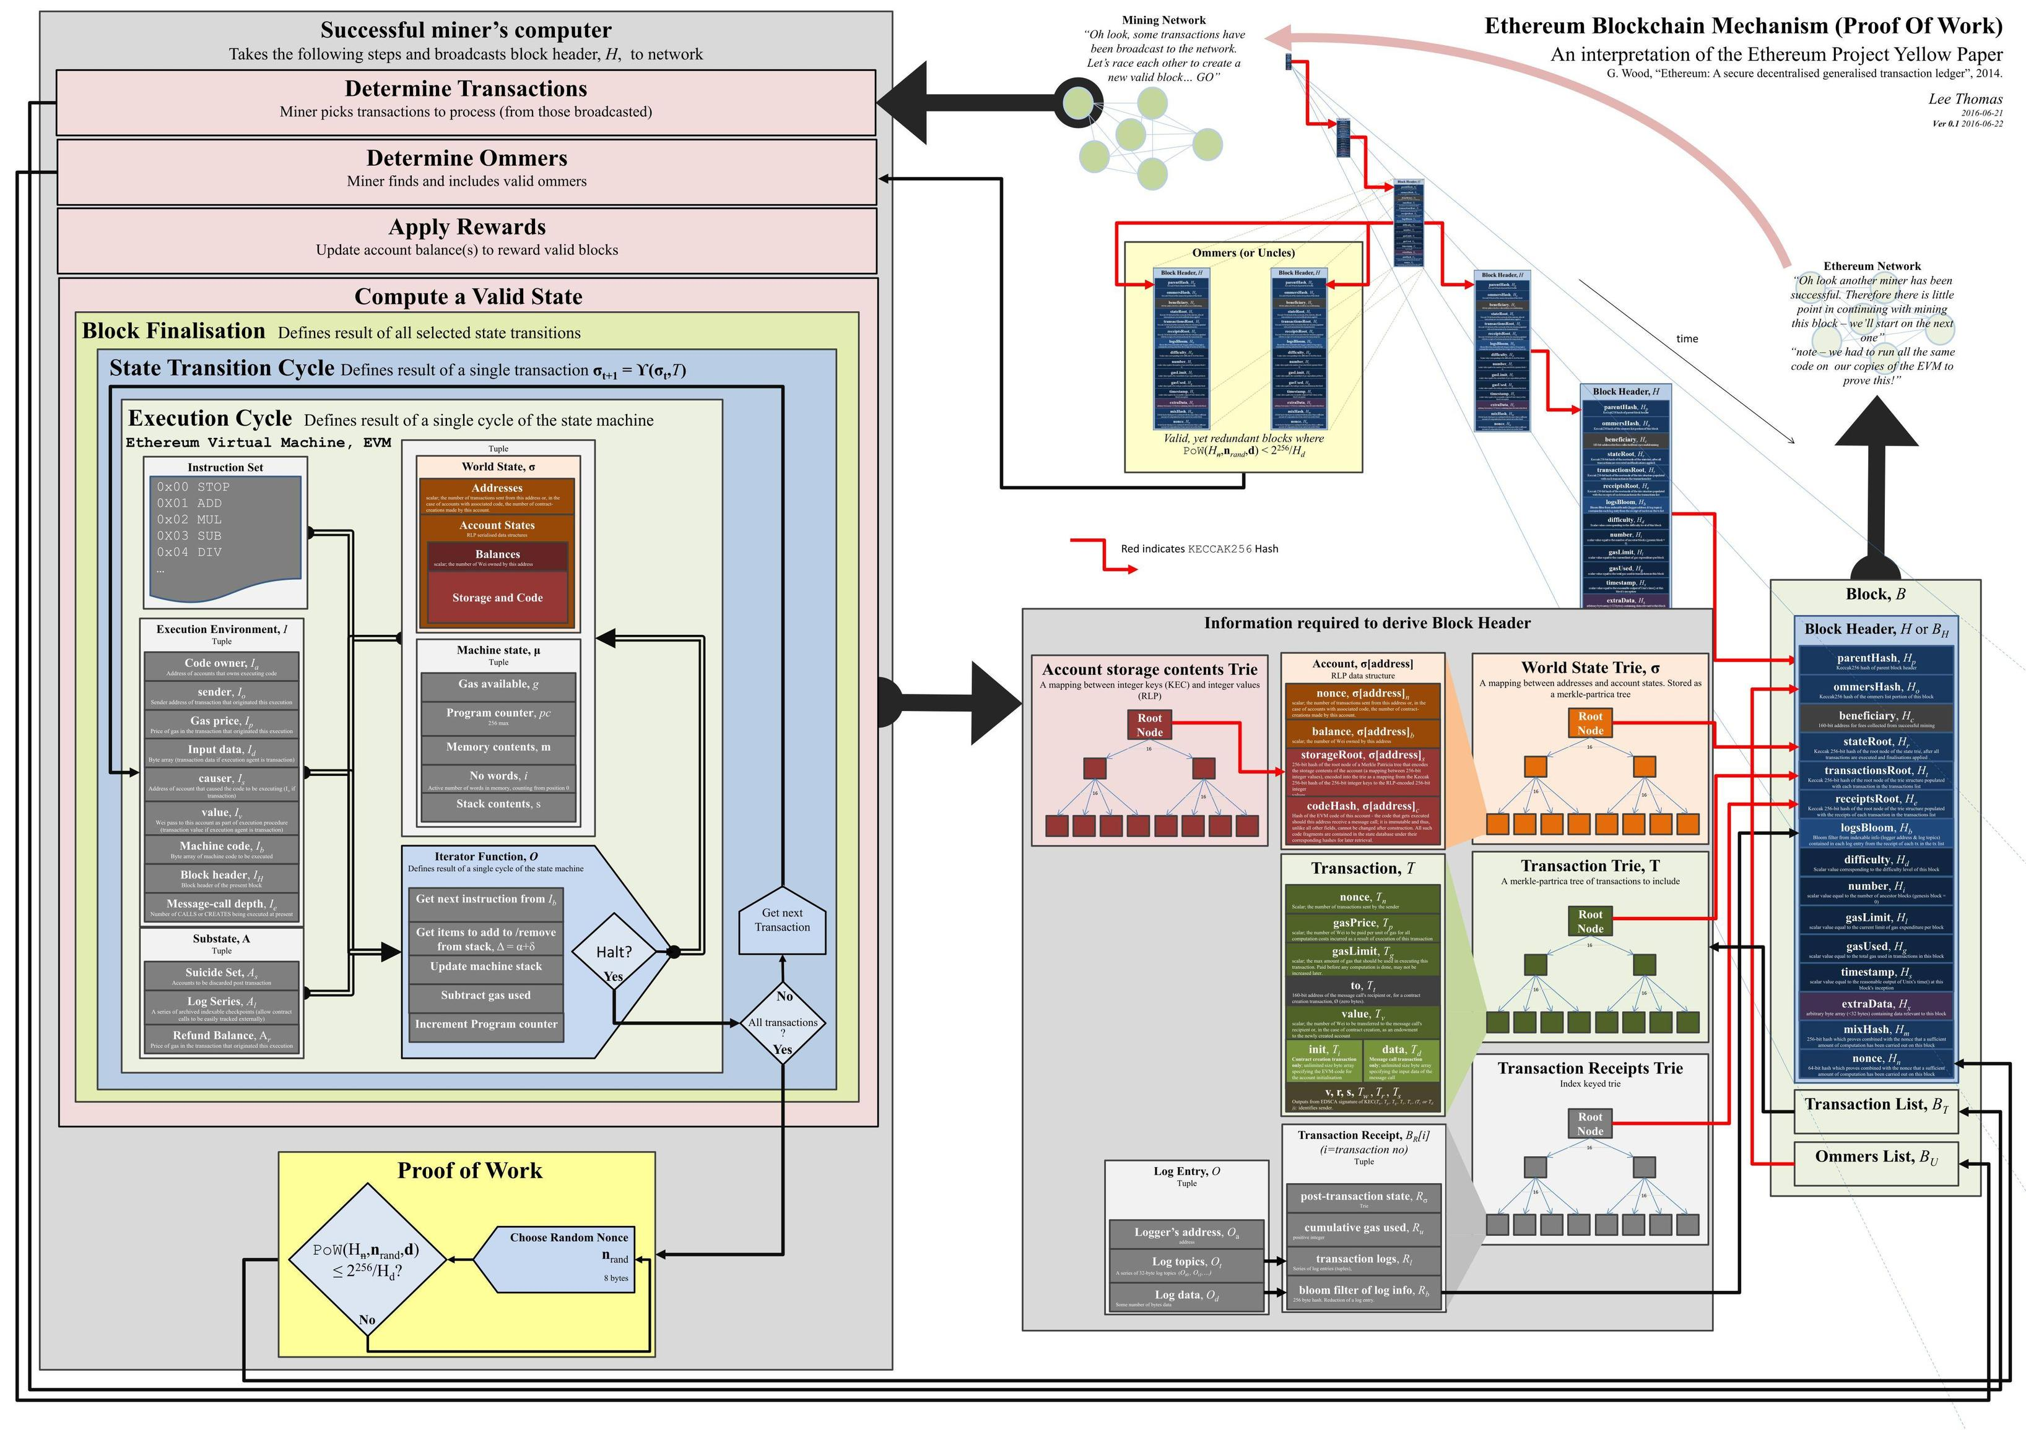

Slide 32
